Slide 1

Big Data Analytics with
An Mai
credit to Quang Vu (Aduro)

Slide 2
What to Expect from this talk
Introduction to Big Data
Introduction to Apache Spark
How to process Big Data using PySpark
Notes:
Where big data come from: give some case study, examples, etc.
Potential tool: Apache Spark – fast, effective, easy-to-use

Slide 3
Motivation
Why Spark?
Big Data is becoming bigger and bigger.
Store, process and use big amount of data for machine learning.
Prerequisites
Originally, it’s in Scala
Basic programming skills and some analytical experiences
Some experiences with Python
Notes:
- There're some background required to get the sense of this talk.

Slide 4
Big Data
Notes:
Still having some other kinds of unstructured data which is not scoped by humans. Similar to “tảng băng chìm”.
=> how could we come up with it when we cannot see/feel about it.

Slide 5
Why all these matter?
In the past:
  1918, Spanish flu: 0.5B people infected, 10M people killed
  No vaccine 🡪 slow its spread
CDC (traditional way)
2009, a new flu virus was discovered
Google Flu Trends
  Detected outbreak 2 weeks ahead
  Initially 97% accurate
Nowcasting -> forecasting
Humm, think about Covid19 today ...
Notes:
CDC: take 2 week to summarize data from healthcare agency => danger
2009, Google launch an algorithm to predict the flu
What Google did: based on keywords users browsing, based on Google map, historical data from CDC => location of infected people => prediction very quickly (nearly immediately) with high accuracy.
=> real time prediction from leveraging big data.

Slide 6
Where does Big Data come from?
Online activity
  Click, Server request, Transaction, Network message, …
User generated content (web and mobile)
  Facebook, Instagram, Twitter, YouTube, …
Health and scientific computing:
  EMR, Genomics, medical images.
Graph data
  Social networks, computer networks, road networks
Web server and machine system log files, source codes.
IOT: GPS, sensors, ...
Financial data.
Notes:
Origin of big data : give some examples. For every second, there’re milions of activities generated
Gene, healthcare data generated continously.
Log file: record the activities, behaviors
IOT data: sensors, cameras, radar.
=> unstructured data => complex, difficult to handle with.
=> big data (it not only means “big size”, but also “complexity of the data”)

Slide 7

Is it extremely complex?
Notes:
Yes or No, depending on the viewpoints and application direction

Slide 8
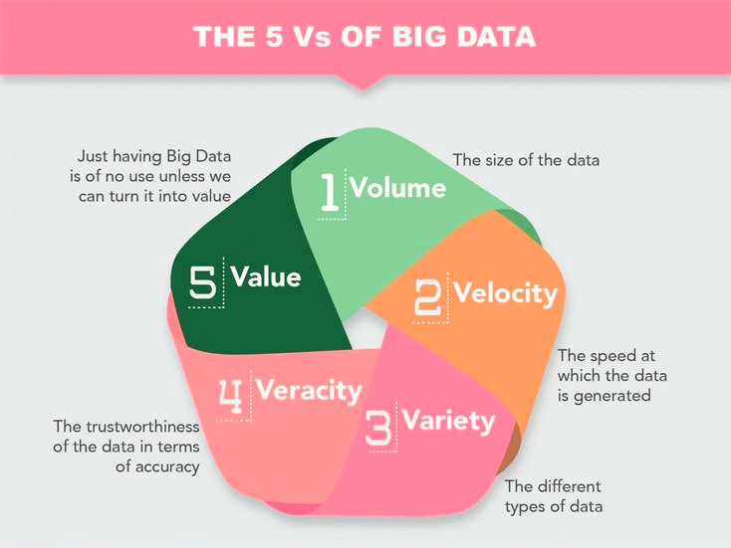
4 Vs of big data is outupdated
The other missing V comes from practical viewpoint
Notes:
- 4 Vs of big data is out updated since it’s the time of too too big data => select the appropriate values of data is more important

Slide 9
Types of data
Structured
Semi-structured
Unstructured
  relational database
  formatted messages
  XML documents
  tagged texts
  plain text
  media
ETL
Notes:
This is illustration for structured data (well-organized, clear structure, well-defined).
Semi-structured data: XML, json (we can add more keys to the available ones, no need to require for a pre-defined schema)
Unstructured data: plain text, media.
=> Goal: big data analysis: simplify the semi/un-strucrured data, and try to convert them into structured ones. Traditional process called ETL.

Slide 10
Big Data problem
Traditional analysis: Unix shell commands, R, Python
  All run in a single machine!
Data growing faster than computational speeds
Growing data sources
  A single machine cannot process or even store all the data!
  Need a scalable, reliable, standard environment
Solution is to distribute data over cluster of machines
Based on clouds: storage and computational resources.
Notes:
- Popular tools to analyze data, in general, still in local machime => limitation.
Data is generated more/faster than the computer process.
Data sources increase continously via time => 1 machine cannot contain all data we'd like to analyze.
=> Distribute data.

Slide 11
Processing & ML with big data
Data Processing ETL (extract, transform, load)
Data processing
  Traditional ETL (extract, transform, load)
  Data Stores (HBase, ……..)
  Tools for processing
Machine Learning
Leverage many machines in distributed way
Distributed Computing
Big Datasets
Machine
Learning
Working in this are is really challenging, which is the main goal of modern big data analytics, and require new methods to store and process Big Data

Slide 12
Pioneer Approach
Notes:
According to its co-founders, Doug Cutting and Mike Cafarella, the genesis of Hadoop was the Google File System paper that was published in October 2003.^{[16][17]} This paper spawned another one from Google – "MapReduce: Simplified Data Processing on Large Clusters".^{[18]} Development started on the Apache Nutch project, but was moved to the new Hadoop subproject in January 2006.^{[19]} Doug Cutting, who was working at Yahoo! at the time, named it after his son's toy elephant.^{[20]} The initial code that was factored out of Nutch consisted of about 5,000 lines of code for HDFS and about 6,000 lines of code for MapReduce.
In March 2006, Owen O’Malley was the first committer to add to the Hadoop project;^{[21]} Hadoop 0.1.0 was released in April 2006.^{[22]} It continues to evolve through contributions that are being made to the project.^{[23]}
The common utilities that support the other Hadoop modules

Slide 13
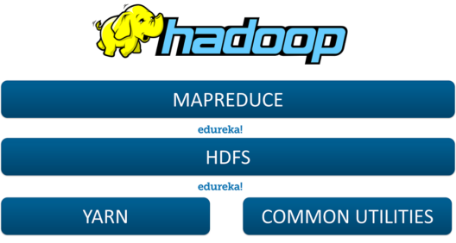
It's Hadoop

Slide 14
Hadoop Ecosystem
Provide Scalability
  on commercial hardware
Support Fault Tolerance
Can handle large and diverse datasets
  Text, Graph, IoT, Streaming Data, Images, Videos…
Enable Shared Environment
Provides Value
  Cost
  Big community
Notes:
- Fault tolerance refers to the ability of a system (computer, network, cloud cluster, etc.) to continue operating without interruption when one or more of its components fail.
- The objective of creating a fault-tolerant system is to prevent disruptions arising from a single point of failure, ensuring the high availability and business continuity of mission-critical applications or systems.
- Fault-tolerant systems use backup components that automatically take the place of failed components, ensuring no loss of service. These include:
+ Hardware systems that are backed up by identical or equivalent systems. For example, a server can be made fault tolerant by using an identical server running in parallel, with all operations mirrored to the backup server.
+ Software systems that are backed up by other software instances. For example, a database with customer information can be continuously replicated to another machine. If the primary database goes down, operations can be automatically redirected to the second database.
+ Power sources that are made fault tolerant using alternative sources. For example, many organizations have power generators that can take over in case main line electricity fails.

Slide 15
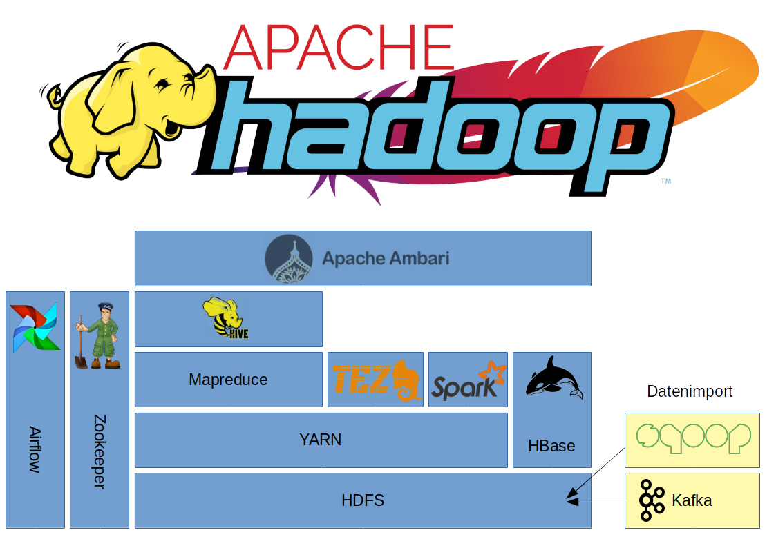
A picture of Hadoop Ecosystem
A
B
C
D
Layer Diagram
Notes:
ZooKeeper is a centralized service for maintaining configuration information, naming, providing distributed synchronization, and providing group services. All of these kinds of services are used in some form or another by distributed applications.
YARN is a large-scale, distributed operating system for big data applications. The technology is designed for cluster management and is one of the key features in the second generation of Hadoop
Pig and Hive are the two key components of the Hadoop ecosystem. What does pig hadoop or hive hadoop solve? Pig hadoop and Hive hadoop have a similar goal- they are tools that ease the complexity of writing complex java MapReduce programs.

Slide 16
Basic Modules of Hadoop
Hadoop Common: libraries and utilities needed for Hadoop cluster
Storage: Distributed File System (HDFS)
Resource management: YARN
Processing mechanism: Map-Reduce
Other Modules: Zookeeper, Impala, Oozie, etc.
Pig
Scripting
Hive
SQL Like Query
Spark, Storm, Tez, etc.
HBase
Non-relational Database
Map-Reduce
Distributed Processing
Others
Distributed Processing
Yarn
Resource Manager
HDFS Distributed File System (Storage)
Notes:
- NoSQL data store build on top of HDFS
- HDFS good for:
Large files
Streaming data
- Not good for:
Lots of small files
Random access to files
Design of HDFS
- Master-Slave design
- Master Node
+ Single NameNode for managing metadata
- Slave Nodes
+ Multiple DataNodes for storing data
- Other
+ Secondary NameNode as a backup

Slide 17
Computational Challenging
On the road to Map - Reduce
Notes:
You can safely remove this slide. This slide design was provided by SlideModel.com – You can download more templates, shapes and elements for PowerPoint from http://slidemodel.com

Slide 18
Cluster computing challenges
How to split work across machines?
How to deal with failures?
Notes:
list out the challenges: machine die, machine go slow, how to make machines recognize to each other, how could they collaborate.

Slide 19

Counting example
{
:2
:2
…}
{
:8
{
:3
:4
…}
:5
:4
{
:2
:3}
…}
{
:2
…}
Notes:
An example.
Paralell partition: partition in different machines.
Need a machine to summarize data.
This requires all the machines run well and return the results quite the same time.

Slide 20
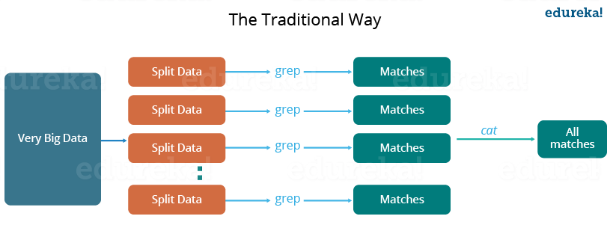
Traditional approach (photo taken from Edureka)
Notes:
Critical path problem: It is the amount of time taken to finish the job without delaying the next milestone or actual completion date. So, if, any of the machines delays the job, the whole work gets delayed.
Reliability problem: What if, any of the machines which is working with a part of data fails? The management of this failover becomes a challenge.
Equal split issue: How will I divide the data into smaller chunks so that each machine gets even part of data to work with. In other words, how to equally divide the data such that no individual machine is overloaded or under utilized. Single split may fail: If any of the machine fails to provide the output, I will not be able to calculate the result. So, there should be a mechanism to ensure this fault tolerance capability of the system.
Aggregation of result: There should be a mechanism to aggregate the result generated by each of the machines to produce the final output.

Slide 21
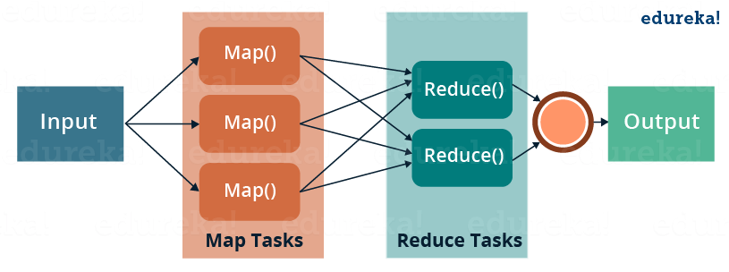
MapReduce mechanism (photo taken from Edureka)
Notes:
MapReduce is a programming framework that allows us to perform distributed and parallel processing on large data sets in a distributed environment.
MapReduce consists of two distinct tasks – Map and Reduce.
As the name MapReduce suggests, reducer phase takes place after mapper phase has been completed.
So, the first is the map job, where a block of data is read and processed to produce key-value pairs as intermediate outputs.
The output of a Mapper or map job (key-value pairs) is input to the Reducer.
The reducer receives the key-value pair from multiple map jobs.
Then, the reducer aggregates those intermediate data tuples (intermediate key-value pair) into a smaller set of tuples or key-value pairs which is the final output.

Slide 22
MapReduce: Simple Programming for Big Data
Based on Google’s MR paper (2004)
MapReduce: simple programming paradigm for the Hadoop ecosystem
Traditional parallel programming requires expertise of different computing/systems concepts
  examples: multithreads, synchronization mechanisms (locks, semaphores, and monitors )
  incorrect use: can crash your program, get incorrect results, or severely impact performance
  NOT fault tolerant to hardware failure
MapReduce Proramming: greatly simplifies running code in parallel
  don't have to deal with any of above issues
  only need to create, map and reduce functions
Notes:
Fault Tolerance simply means a system’s ability to continue operating uninterrupted despite the failure of one or more of its components. This is true whether it is a computer system, a cloud cluster, a network, or something else. In other words, fault tolerance refers to how an operating system (OS) responds to and allows for software or hardware malfunctions and failures.

Slide 23
Simple illustrative Paradigm
Apply function Map: Apply a function to all the elements of List list1=[1,2,3,4,5]; square x = x * x list2=Map square(list1) print list2 -> [1,4,9,16,25] | Reduce: Combine all the elements of list for a summary list1 = [1,2,3,4,5]; A = reduce (+) list1 Print A -> 15
Input
Map
Reduce
Output

Slide 24
Back to the counting problem?
MAP
REDUCE
{
:2
{
:8
:2
:4}
…}
{
:3
{
:5}
…}
{
:2
{
:4}
…}
{
:2
{
:3}
…}
Notes:
An example of Map-reduce idea.
Map: compute in each machine.
Reduce: summarize the results to return to user. Have to pre-define the attributes to reduce.

Slide 25
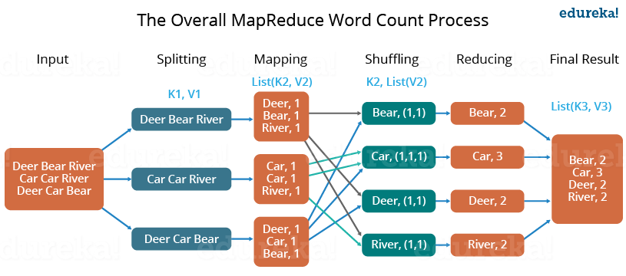
Another counting example:
(Dear, Bear, River, Car, Car, River, Deer, Car and Bear)
Notes:
First, we divide the input in three splits as shown in the figure. This will distribute the work among all the map nodes.
Then, we tokenize the words in each of the mapper and give a hardcoded value (1) to each of the tokens or words. The rationale behind giving a hardcoded value equal to 1 is that every word, in itself, will occur once.
Now, a list of key-value pair will be created where the key is nothing but the individual words and value is one. So, for the first line (Dear Bear River) we have 3 key-value pairs – Dear, 1; Bear, 1; River, 1. The mapping process remains the same on all the nodes.
After mapper phase, a partition process takes place where sorting and shuffling happens so that all the tuples with the same key are sent to the corresponding reducer.
So, after the sorting and shuffling phase, each reducer will have a unique key and a list of values corresponding to that very key. For example, Bear, [1,1]; Car, [1,1,1].., etc.
Now, each Reducer counts the values which are present in that list of values. As shown in the figure, reducer gets a list of values which is [1,1] for the key Bear. Then, it counts the number of ones in the very list and gives the final output as – Bear, 2.
Finally, all the output key/value pairs are then collected and written in the output file.

Slide 26
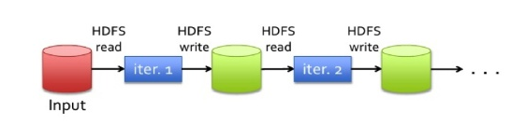
Map Reduce: it’s still boring ...
Iterative jobs involve a lot of disk I/O for each repetition
In general, based on “Acyclic Data Flow” from Disk to Disk (HDFS)
🡺 Disk I/O is very slow!
Notes:
- Map-reduce from Google (idea).
- There a framework to implement this idea called Hadoop. Sequencely, Map-reduce -> hard disk, then Map-reduce -> hard disk.

Slide 27
Other Shortcoming of MapReduce
Forces data processing into Map and Reduce
  Other workflows missing: join, filter, flatMap, groupByKey, union, intersection, …
Read & write to Disk before & after Map Reduce (stateless machine)
  NOT efficient for iterative tasks, i.e. Machine Learning
Support only Java natively
  Support for others languages needed
Only for Batch processing
  Interactivity, streaming data

Slide 28
Opportunity
Tech Trend
  Cost of memory is reducing 🡪 keep more data in memory
Create new distributed execution engine
The rise of data analytics.
🡪 Apache Spark
Notes:
Price of mamory decrease (cheaper) => want to store data in memory.
=> Give birth of Apache Spark.

Slide 29
Spark comes into play
Notes:
You can safely remove this slide. This slide design was provided by SlideModel.com – You can download more templates, shapes and elements for PowerPoint from http://slidemodel.com

Slide 30
Apache Spark
Built on top the idea of MapReduce.
Modern, interactive and ease to use.
Officially, Spark computing framework provides programming abstraction and parallel runtime to hide complexities (partition processes) of fault-tolerance and slow machines.
Notes:
It can solve the issues of handling the failure of machines.
Fault-tolerance: machine die or stand by.
Hide complexites: help users avoid the coding for structure the distributed mechanism.
Basic concepts
RDD: the basic abstraction of Spark. It distributes data object on to multiple machines, and process in memory, which is faster than processing on a single machine like R or Python. But it’s not organized in named columns.
Dataframe: built on top of rdd and can have a schema with column names and data types. It’s faster than rdd because it gives Spark more information about the data.
Lazy evaluation: Spark doesn’t actually execute data when you use transformations until you call an action.
Transformations: select, filter/where, sort/orderBy, join, groupBy, agg
Actions: show, take, count, collect, describe, cache, printSchema

Slide 31
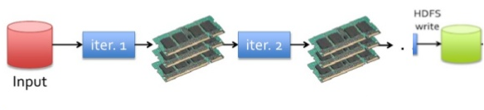
Use Memory instead of Disk
🡺 10-100x faster than Hadoop MapReduce
Notes:
- Above figure (traditional one): Hadoop idea.
- Apache Spark (new): Read one time in hard disk, all other steps carried out in memory.

Slide 32
Spark and Map Reduce differences
 | Apache Hadoop MR | Apache Spark
Storage | Disk only | In-memory or on disk
Operations | Map and Reduce | Many transformations and actions, including Map and Reduce
Execution model | Batch | Batch, iterative, streaming
Languages | Java | Scala, Java, Python and R
Notes:
- Spark can be installed standalone, or in server (included the functionality of managing clusters)
- YARN: manage clusters (Hadoop clusters). They can install Spark in YARN clusters.

Slide 33
Apache Spark vs Apache Hadoop
 | Hadoop MR Record (2013) | Spark Record (2014)
Data Size | 102.5 TB | 100 TB
Elapsed Time | 72 mins | 23 mins
# Nodes | 2100 | 206
# Cores | 50400 physical | 6592 virtualized
Cluster disk throughput | 3150 GB/s (est.) | 618 GB/s
Network | dedicated data center, 10Gbps | virtualized (EC2) 10Gbps network
Sort rate | 1.42 TB/min | 4.27 TB/min
Sort rate/node | 0.67 GB/min | 20.7 GB/min
Spark, 3x faster with 1/10 the nodes
Sort benchmark, Daytona Gray: sort of 100 TB of data (1 trillion records)
http://databricks.com/blog/2014/11/05/spark-officially-sets-a-new-record-in-large-scale-sorting.html
Notes:
- Comparison in data sorting.

Slide 34
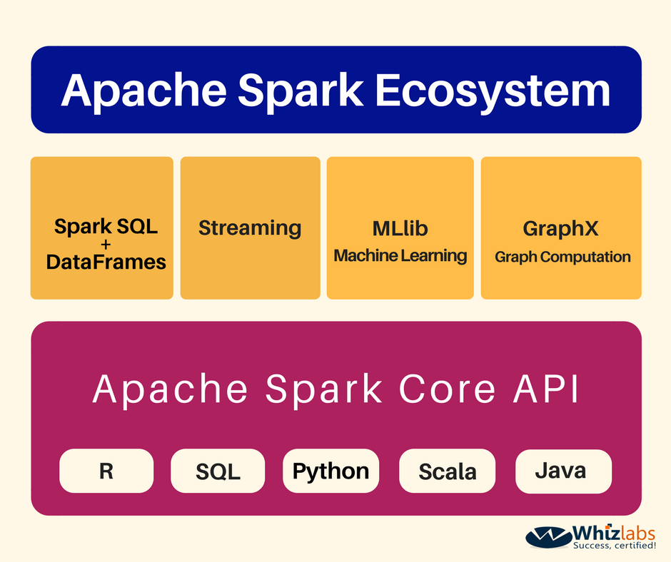
Components
Notes:
Components from Spark.
Spark SQL: using similar style of SQL to aggregate data in Spark environment.
Spark streaming: stream real time data (IOT)
Mllib: lib for data scientists (Spark clustering, LDA, etc.)
GraphX: handle with graph data (social networks)

Slide 35
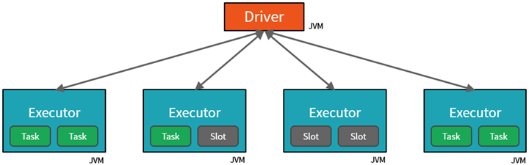
Architecture
A master-worker type architecture
  A driver or master node
  Worker nodes
The master send works to the workers and either instructs them to pull data from memory or from hard disk (or from another source like S3 or HDSF)
Notes:
1 Driver node and many workers nodes. For newest version, there’s still Stand By Nodes or using another Driver Nodes (contains all info of all clusters).
In Executor, there’re Task boxes (it means cores in this machine) => multi-thread in a local machine and distributed via clusters.

Slide 36
Architecture(2)
A Spark program first creates a SparkContext object
  SparkContext tells Spark how and where to access a cluster
  The master parameter for a SparkContext determines which type and size of cluster to use
Master parameter | Description
local | Run Spark locally with one worker thread (no parallelism)
local[K] | Run Spark locally with K worker threads (ideal set to number of cores)
spark://HOST:PORT | Connect to a Spark standalone cluster
mesos://HOST:PORT | Connect to a Mesos cluster
yarn | Connect to a YARN cluster
Notes:
Create Spark program.
K: numbers of cores in a local machine.
Mesos: another of Spark clusters management beside YARN.

Slide 37
DataFrame
A primary abstraction in Spark
  Immutable once constructed
  Track lineage information to efficiently re-compute lost data
  Enable operations on collection of elements in parallel
To construct DataFrame
  By parallelizing existing Python collections (lists)
  By transforming an existing Spark DF or pandas DF
  From files in HDFS or other storage system
Notes:
Originally, based on RDD: primary data abstraction in Apache Spark and the core of Spark ("Spark Core”):
Resilient, i.e. fault-tolerant, help to re-compute missing or damaged partitions due to node failures.
Distributed with data residing on multiple nodes in a cluster.
Dataset is a collection of partitioned data with primitive values or values of values, e.g. tuples or other objects (that represent records of the data you work with).
DataFrame: Main object of Spark (from 2.0 version): high level of RDD, optimize the re-build the computation process of each cluster, & support parallel computing.

Slide 38
Using DataFrame: an example in pyspark
>>> data = [(‘Alice’, 1), (‘Bob’, 2), (‘Bob’, 2)]
>>> df1 = sqlContext.createDataFrame(data, [‘name’, ‘age’])
[Row(name=u’Alice’, age=1), Row=(name=u’Bob’, age=2), Row=(name=u’Bob’, age=2)]
Notes:
Original, RDD doesn't have schema while DataFrame supports the schema.
There are 2 main functions related to Dataframe: Transformation & Action.

Slide 39
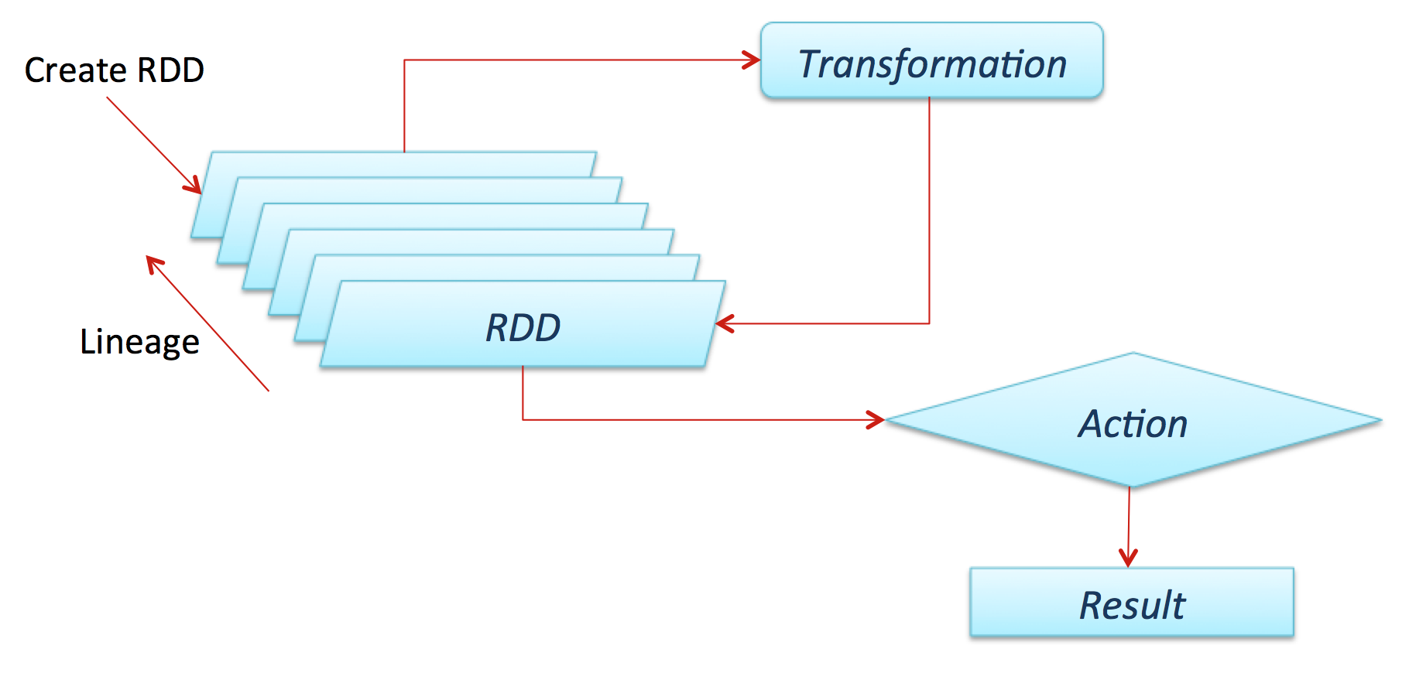
Original Mechanism
Notes:
- At the beginning of Spark
- Create many RDD replicas
- Performed via 2 functionality (Transformation & Action)

Slide 40
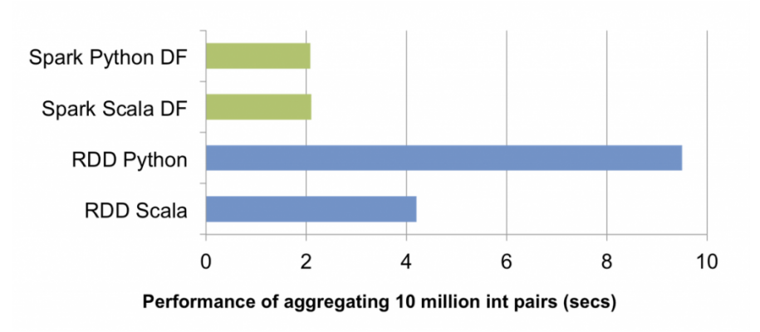
RDDs vs. DFs
RDDs provide a low level interface into Spark
DFs have a schema
DFs are cached and optimized by Spark community
DFs are built on top of the RDDs and the core Spark API

Slide 41
Transformations
Create new DF from an existing one
Use lazy evaluation
  Just recipes
  Nothing executes
  Spark saves recipes for transformation source
Notes:
- Create new dataframe from old dataframes, for example.

Slide 42
Some useful Transformations
Transformation | Description
select(*cols) | Selects columns from this DataFrame
drop(col) | Returns a new Dataframe that drops the specific column
filter(func) | Returns a new DataFrame formed by selecting those rows of the source on which func returns true
where(func) | Where is an alias for filter
distinct() | Returns a new DataFrame that contains the distinct rows of the source DataFrame
sort(*cols, **kw) | Returns a new DataFrame sorted by the specified columns and in the sort order specified by kw
Notes:
- Functions which handle with dataframe.

Slide 43
Using Transformations
>>> data = [(‘Alice’, 1), (‘Bob’, 2), (‘Bob’, 2)]
>>> df1 = sqlContext.createDataFrame(data, [‘name’, ‘age’])
>>> df2 = df1.distinct()
[Row(name=u’Alice’, age=1), Row=(name=u’Bob’, age=2)]
>>> df3 = df2.sort(“age”, asceding=False)
[Row=(name=u’Bob’, age=2), Row(name=u’Alice’, age=1)]
Notes:
- df2 is created from df1, but is not saved yet. Spark only remember process.

Slide 44
Actions
Cause Spark to execute recipe to transform source
Mechanisms for getting results out of Spark
Notes:
- In “Action” part, Spark will execute all things defined in part “Transformation”

Slide 45
Some useful Actions
Action | Description
show(n, truncate) | Prints the first n rows of this DataFrame
take(n) | Returns the first n rows as a list of Row
collect() | Returns all the records as a list of Row (*)
count() | Returns the number of rows in this DataFrame
describe(*cols) | Exploratory Data Analysis function that computes statistics (count, mean, stddev, min, max) for numeric columns

Slide 46
Using Actions: an example in pyspark
>>> data = [(‘Alice’, 1), (‘Bob’, 2)]
>>> df = sqlContext.createDataFrame(data, [‘name’, ‘age’])
>>> df.collect()
[Row(name=u’Alice’, age=1), Row=(name=u’Bob’, age=2)]
>>> df.count()
2
>>> df.show()
+-------+--------+
|name| age |
+-------+-------+
|Alice| 1|
|Bob | 2|
+-----+-------+

Slide 47
Caching
>>> linesDF = sqlContext.read.text(‘…’)
>>> linesDF.cache()
>>> commentsDF = linesDF.filter(isComment)
>>> print linesDF.count(), commentsDF.count()
>>> commentsDF.cache()

Slide 48
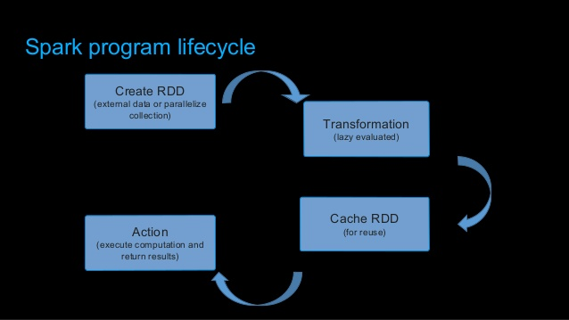
Spark Program Lifecycle
Notes:
Create DataFrames from external data or createDataFrame from a collection in driver program
Lazily transform them into new DataFrames
cache() some DataFrames for reuse
Perform actions to execute parallel computation and produce results

Slide 49
Machine Learning Library in Spark (MLlib)
2 packages
  spark.mllib
  spark.ml
ML algorithms
  Common learning algorithms such as classification, regression, clustering and collaborative filtering
Featurization
  Feature extraction, transformations, dimensionality reduction and selection
Utilities
  Linear algebra, statistics, data handling, …

Slide 50
ML: Transformer
A Transformer is a class which can transform a DF into another DF
A Transformer implements transform()
Examples
  HashisngTF
  LogisticRegressionModel
  Binarizer
Notes:
- HashingTF is a Transformer which takes sets of terms and converts those sets into fixed-length feature vectors.
- Binarization is the process of thresholding numerical features to binary (0/1) features.
- Binarizer takes the common parameters inputCol and outputCol, as well as the threshold for binarization.

Slide 51
ML: Estimator
An Estimator is a class which can take a DF and return a Transformer
An Estimator implements fit()
Examples
  LogisticRegression
  StandardScaler
  Pipeline

Slide 52
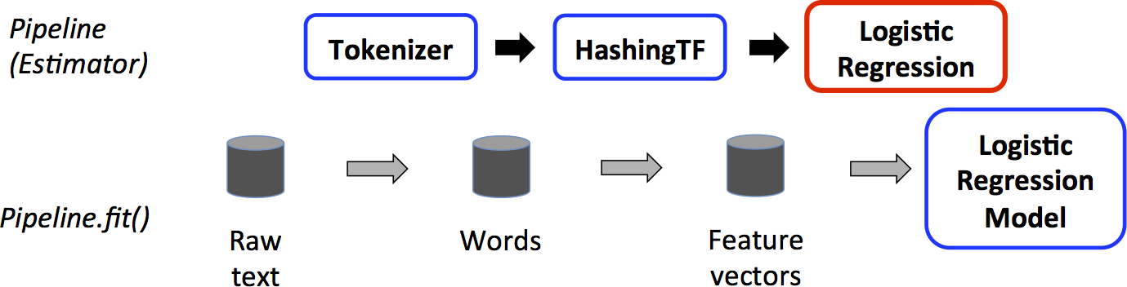
ML: Pipeline
A Pipeline is an estimator that specified as a sequence of stages and each stage can be either estimators or transformers.
Notes:
The top row represents a Pipeline with three stages. The first two (Tokenizer and HashingTF) are Transformers (blue), and the third (LogisticRegression) is an Estimator (red).
The bottom row represents data flowing through the pipeline, where cylinders indicate DataFrames. The Pipeline.fit() method is called on the original DataFrame, which has raw text documents and labels. The Tokenizer.transform() method splits the raw text documents into words, adding a new column with words to the DataFrame. The HashingTF.transform() method converts the words column into feature vectors, adding a new column with those vectors to the DataFrame. Now, since LogisticRegression is an Estimator, the Pipeline first calls LogisticRegression.fit() to produce a LogisticRegressionModel.
If the Pipeline had more stages, it would call the LogisticRegressionModel’s transform() method on the DataFrame before passing the DataFrame to the next stage.

Slide 53
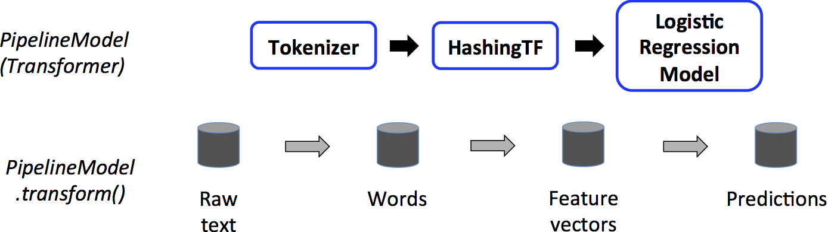
ML: PipelineModel
After a Pipeline.fit() runs, it produces a PipelineModel. This PipelineModel is used at test time.

Slide 54
References
Data Science and Engineering with Spark @EDX
Spark Documentation
  http://spark.apache.org/docs/latest/

Slide 55
Takeaways
Hadoop (HDFS, MapReduce)
  Provides an easy solution for processing of Big Data
  Brings a paradigm shift in programming distributed system
Spark
  Has extended MapReduce for in-memory-based
  for streaming, interactive, iterative and machine learning tasks
  Ease to use with the rise of Machine Learning
Changing the World
  Made data processing cheaper and more efficient and scalable
  Is the foundation of many other tools and softwares

Slide 56
Q&A
Notes:
Spark: when not to use
Even though Spark is versatile, that doesn’t mean Spark’s in-memory capabilities are the best fit for all use cases:
For many simple use cases Apache MapReduce and Hive might be a more appropriate choice
Spark was not designed as a multi-user environment
Spark users are required to know that memory they have is sufficient for a dataset
Adding more users adds complications, since the users will have to coordinate memory usage to run code

Slide 57
A demo

Slide 58
THANK YOU!!!
Notes:
You can safely remove this slide. This slide design was provided by SlideModel.com – You can download more templates, shapes and elements for PowerPoint from http://slidemodel.com

